Slide 1

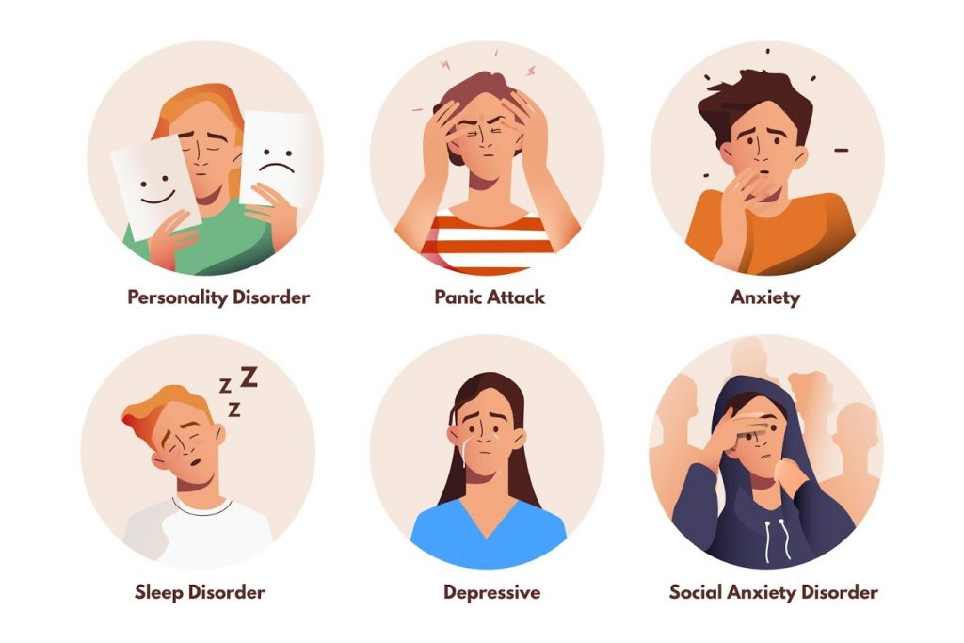

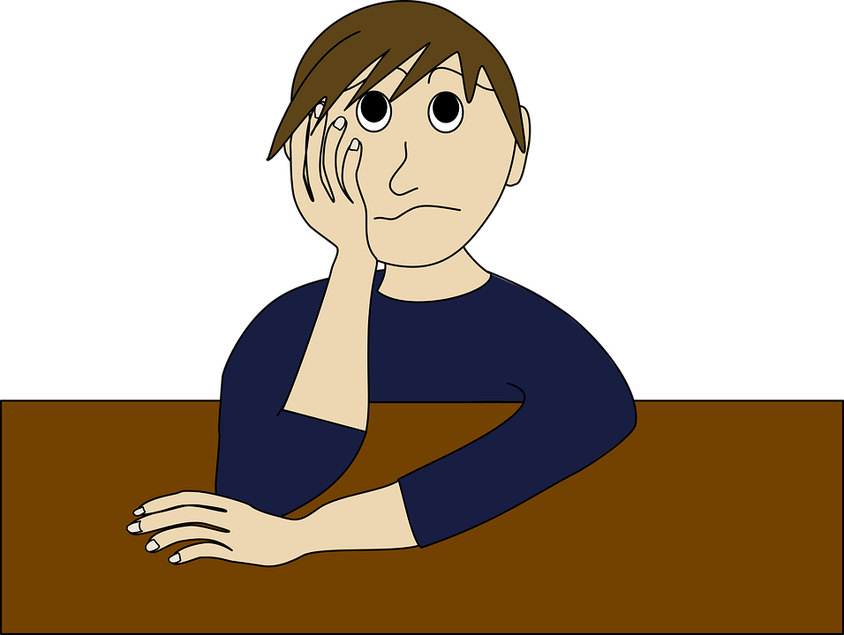

Negative Effects On Victims
Emotional Impact
Psychological Impact
Social Impact
Physical Impact
Financial Impact

